Slide 1
Search: State Space, Uninformed search
Session 03
Henry Lucky, S.Kom., M.Kom.

Slide 2
Learning Outcomes
Session 3
At the end of this session, students will be able to:
LO 2: Apply various search algorithms for agents to solve problems

Slide 3
outline
Session 3
Search
Representing a problem: The Formalism
Problem solving as search
Uninformed Search

Slide 4
Search
How do we plan our holiday
We must consider various preferences and constraints to develop a schedule
One crucial method in formulating such a plan involves the utilization of "hypothetical" thinking.
  Example: On holiday in England
    Currently in Edinburgh
    Flight leaves tomorrow from London
    Need plan to get to your plan
    If I take a 6 A.M train where will I be at 2 P.M? Will I be still able to get to the airport on time?

Slide 5
Search
How do we plan our holiday
This kind of hypothetical reasoning involves asking:
  “What state will I be in after taking certain actions, or after certain sequence of events?”
From this we can reason about particular sequences of events or actions one should try to bring about to achieve a desirable state
Search is a computational method for capturing a particular version of this kind of reasoning

Slide 6
Search
Why search?
Successful
  Success in game playing programs based on search
  Many other AI problems can be successfully solved by search
Practical
  Many problems don’t have specific algorithms for solving them. Casting as search problems is often the easiest way of solving them
  Search can also be useful in approximation
  Problem specific heuristics provides search with a way of exploiting extra knowledge
Some critical aspects of intelligent behavior

Slide 7
Search
Limitation of search
There are many difficult question that are not resolved by search.
In particular, the whole question of how does an intelligent system formulate the problem it wants to solve as a search problem is not addressed by search.
Search only shows how to solve the problem once we have it correctly formulated

Slide 8
Representing a problem: the formalism
State space
To formulate a problem as a search problem we need the following components:
  The initial state : The state where the agent starts​
  Actions : Possible actions available to the agents​
  Transition model : A description what an action does​
  Goal test : Check if a given state is a goal state​
  Path cost : Measure the cost to achieve the goal

Slide 9
Representing a problem: the formalism
State sPace
Once the problem has been formulated as a state space search, various algorithm can be utilized to solve the problem
Solution to the problem will be a sequence of actions/ moves that can transform your current state into a state where your desired condition holds

Slide 10
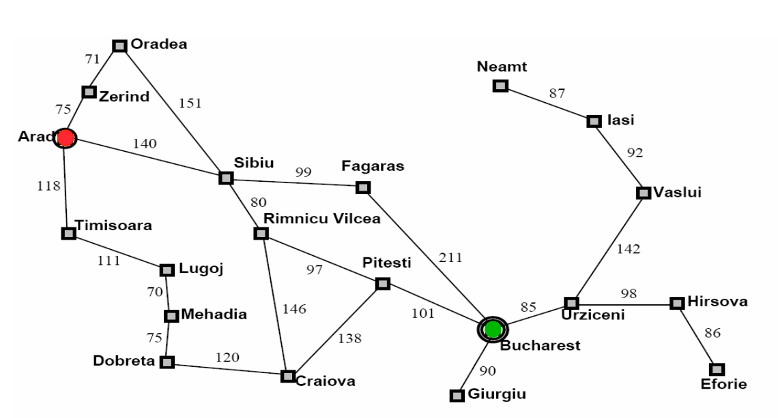
Representing a problem: the formalism
Example: Romania travel
Currently in Arad, need to get to Bucharest by tomorrow to catch a flight.
What is the State Space?

Slide 11
Representing a problem: the formalism
Example: Romania travel
State space:
  The initial state : In (Arad)​
  Actions : Go (Zerind), Go (Zibiu), etc​.
  Transition model : Results (In (Arad), Go (Zerind)) = In(Zerind)​
  Goal test : In (Bucharest)​
  Path cost : Path length in kilometers

Slide 12
Representing a problem: the formalism
Solution
Search tree: models the sequence of actions​
  Root: initial state​
  Branches: actions​
  Nodes: results from actions​
  Expanding:​ Process of generating child nodes (performing an action)​

Slide 13
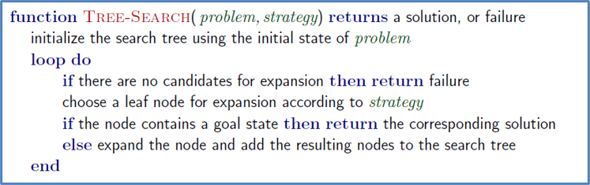
Representing a problem: the formalism
Tree pseudocode

Slide 14
Representing a problem: the formalism
Searching solution
Measuring problem-solving performance​
  Completeness: Is the algorithm guaranteed to find a solution when there is one?​
  Optimality: Does the strategy find the optimal solution?​
  Time complexity: How long does it take to find a solution?​
  Space complexity: How much memory is needed to perform the search?​

Slide 15
Problem solving as search
Introduction
Problem solving
  Finding any solution (goal-driven)
  Finding the cheapest solution (utility-driven)
Uninformed (blind) search (goal-driven)
  Algorithms: Breadth-first search, Uniform-cost search, Depth-first search, Depth-limited search, Iterative-deepening search
Informed search (utility-driven):
  Algorithms: (greedy) Best-first search, A* search

Slide 16
Uninformed search
Definition
These are strategies that adopt a fixed rule for selecting the next state to be expanded
The rule does not change irrespective of the search problem being solved
These strategies do not consider any domain specific information about the particular search problem

Slide 17
Uninformed search
Breadth first search
Expand shallowest unexpanded node​
Implementation: a FIFO queue​

Slide 18
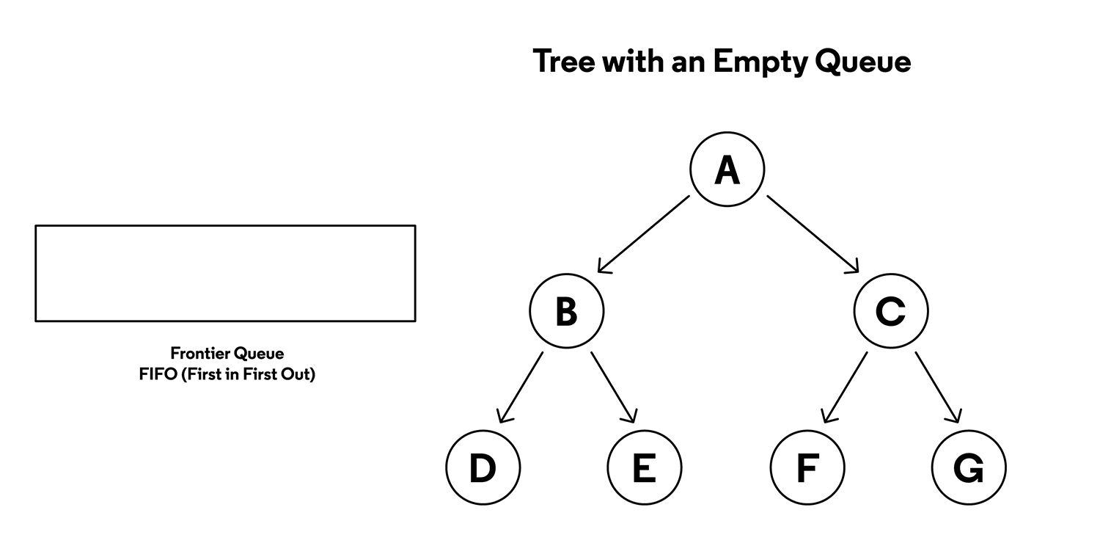
Uninformed search
Breadth first search

Slide 19
Uninformed search
Uniform cost search
Instead of expanding the shallowest node, it expands the node n with the lowest path cost g(n)​
Instead of queue (FIFO), it utilize priority queue based on g(n)​
Also called Dijkstra’s algorithm by the theoretical computer science community.

Slide 20
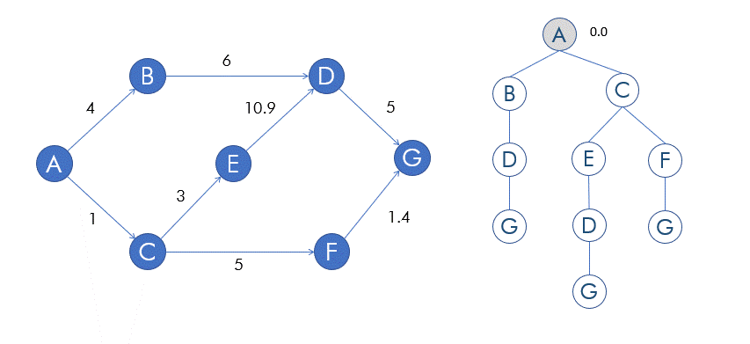
Uninformed search
Uniform cost search
Example of UCS, searching from A to G

Slide 21
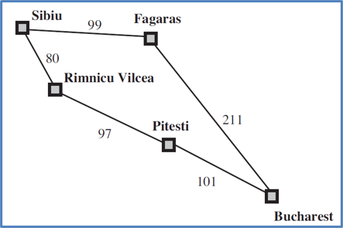
Uninformed search
Uniform cost search: Example
Search the optimal path from Sibiu to Bucharest!

Slide 22
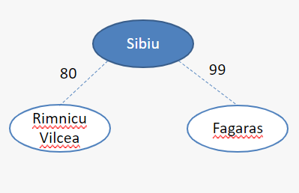
Uninformed search
Uniform cost search: Example

Slide 23
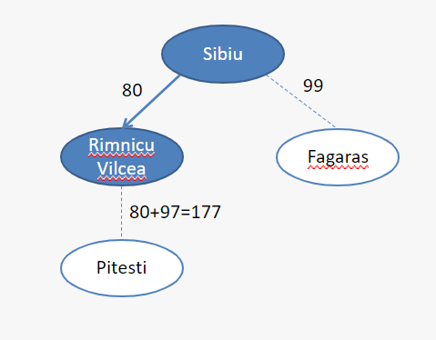
Uninformed search
Uniform cost search: Example

Slide 24
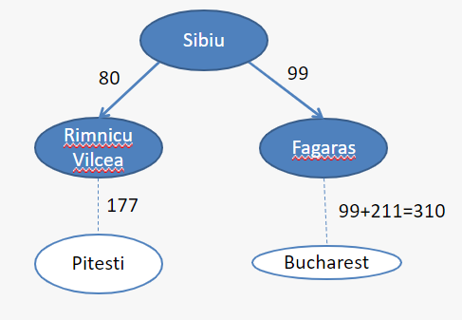
Uninformed search
Uniform cost search: Example

Slide 25
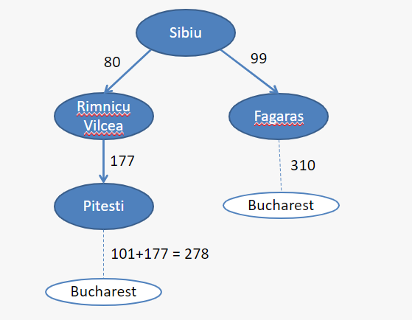
Uninformed search
Uniform cost search: Example

Slide 26
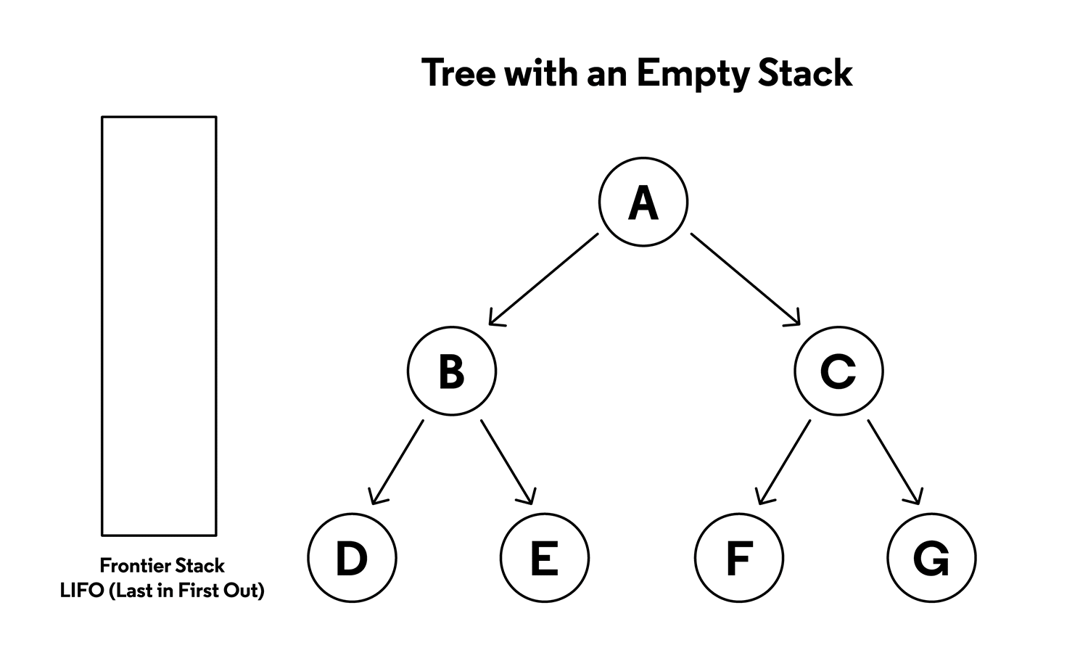
Uninformed search
Depth first search
Expand deepest unexpanded node
Implementation: LIFO
Depth-first search is not cost-optimal
it returns the first solution it finds, even if it is not cheapest.

Slide 27
Uninformed search
Depth limited search & Iterative deepening
To keep depth-first search from wandering down an infinite path, we can use depth-limited search
It is a version of depth-first search in which we supply a depth limit, l, and treat all nodes at depth l as if they had no successors.
However, for most problems we will not know a good depth limit until we have solved the problem.
Iterative deepening search solves the problem of picking a good value for l by trying all values: first 0, then 1, then 2, and so on—until either a solution is found, or the depth-limited search returns the failure value rather than the cutoff value.

Slide 28
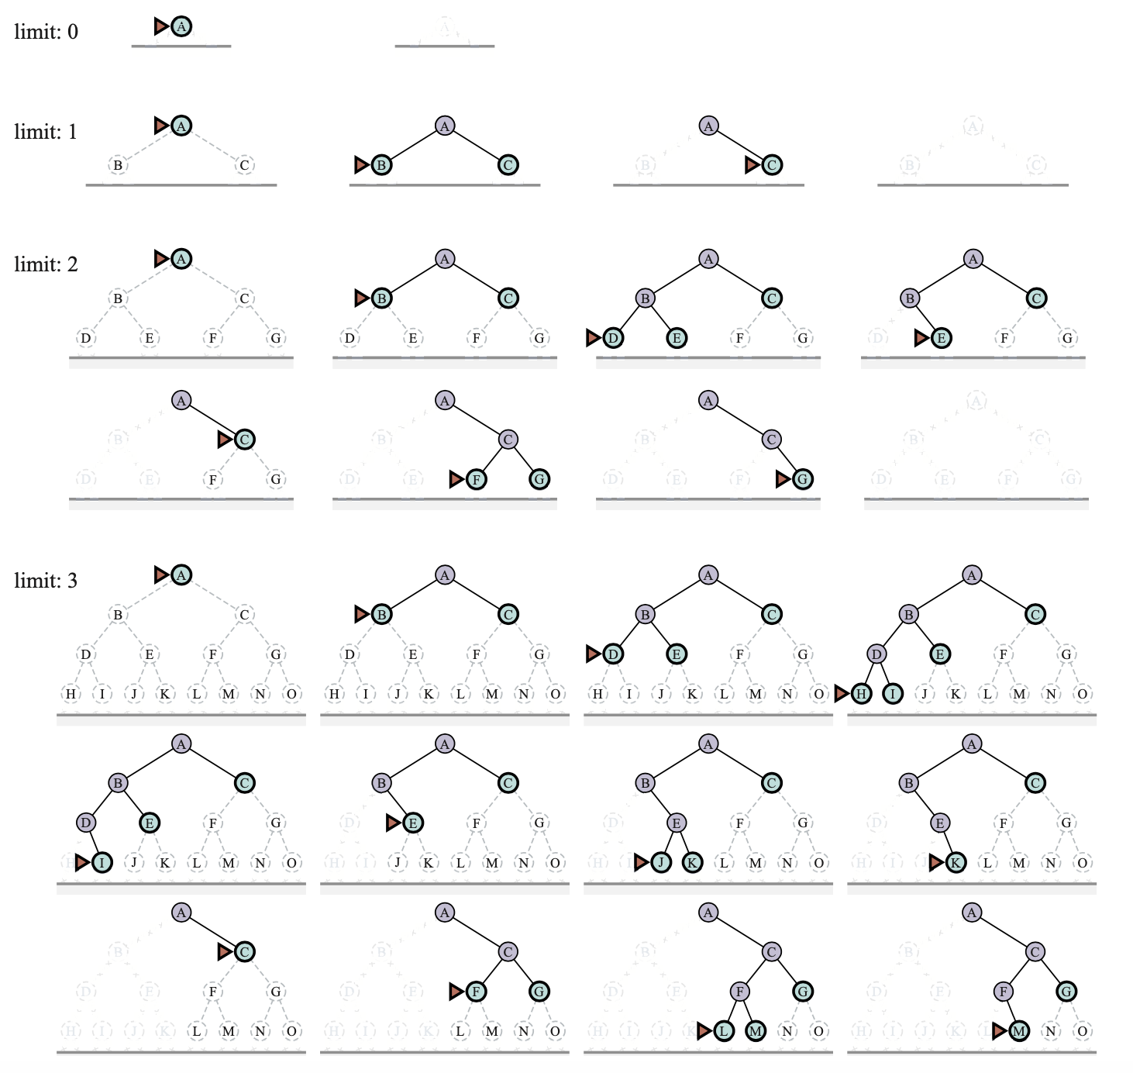
Uninformed search
Depth limited search & Iterative deepening
Example of iterative deepening search for goal M on a binary tree, with the depth limit varying from 0 to 3.

Slide 29




Uninformed search
Depth limited search & Iterative deepening
$$(i)$$
$$(ii)$$
$$(iii)$$
$$(iv)$$

Slide 30


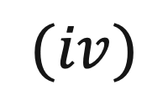

Uninformed search
Depth limited search & Iterative deepening
$$(i)$$
$$(ii)$$
$$(iii)$$
$$(iv)$$

Slide 31

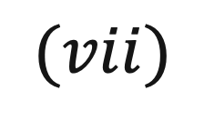
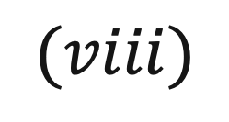
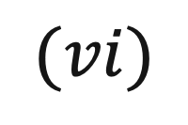
Uninformed search
Depth limited search & Iterative deepening
$$(v)$$
$$(vi)$$
$$(vii)$$
$$(viii)$$

Slide 32
Uninformed search
Depth limited search & Iterative deepening

Slide 33
Uninformed search
Depth limited search & Iterative deepening

Slide 34
Uninformed search
Depth limited search & Iterative deepening

Slide 35
Uninformed search
Depth limited search & Iterative deepening

Slide 36
Uninformed search
Depth limited search & Iterative deepening

Slide 37
Uninformed search
Depth limited search & Iterative deepening

Slide 38
Uninformed search
Depth limited search & Iterative deepening

Slide 39
Uninformed search
Depth limited search & Iterative deepening

Slide 40
Uninformed search
Depth limited search & Iterative deepening

Slide 41
Uninformed search
Depth limited search & Iterative deepening

Slide 42
Uninformed search
Depth limited search & Iterative deepening

Slide 43
Uninformed search
Depth limited search & Iterative deepening

Slide 44
Case study
Simulating searching

Slide 45
Case study
Simulating searching
Simulate the node expansion from start state (S) to reach goal state (G)​ using:
  BFS,
  DFS,
  UCS​

Slide 46
References
Session 3
Russell, S. J., Norvig, P., Chang, M., Devlin, J., Dragan, A., Forsyth, D., Goodfellow, I., Malik, J., Mansinghka, V., Pearl, J., & Wooldridge, M. J. (2022). Artificial intelligence: A modern approach (Fourth edition, global edition). Pearson.
Tinelli, C. (2017). Problem Solving by Search. CS:4420 Artificial Intelligence. https://homepage.cs.uiowa.edu/~tinelli/classes/4420/Spring17/notes/3-problem-solving.pdf
Tinelli, C. (2017). Uninformed Search. CS:4420 Artificial Intelligence. https://homepage.cs.uiowa.edu/~tinelli/classes/4420/Spring17/notes/3a-uninformed-search.pdf
Tinelli, C. (2017). Informed Search. CS:4420 Artificial Intelligence. https://homepage.cs.uiowa.edu/~tinelli/classes/4420/Spring17/notes/3b-informed-search.pdf
Bacchus, F. (n.d.). Search. CSC384 Introduction to Artficial Intelligence. Retrieved October 20, 2023, from https://www.cs.toronto.edu/~fbacchus/csc384/Lectures/csc384-Lecture02-Search.pdf

